Slide 1

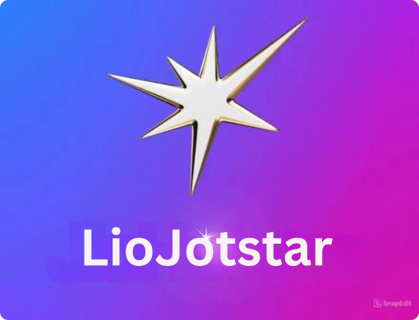
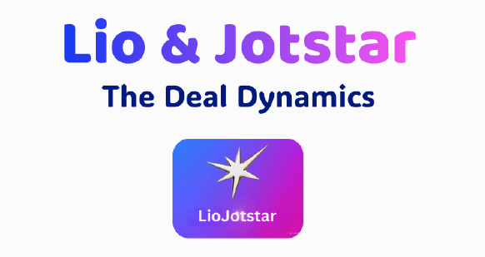
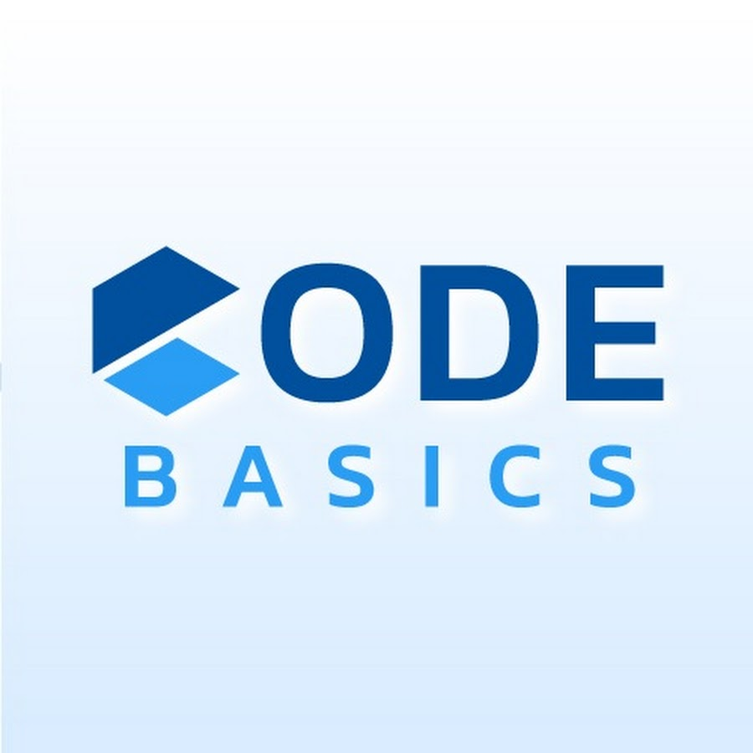
Strategic Insights for OTT Growth & Market Expansion
Resume Project Challenge #14
Presented By:
Nagendra Vallepu
Notes:
Hey, everyone!
I’m Nagendra Vallepu, and today,
I’ll be diving into a strategic analysis of the game-changing merger between Lio, a major telecom provider, and Jotstar, a leading streaming platform.
This merger is set to reshape India’s OTT landscape, bringing together a massive subscriber base and a diverse content library to create a powerful new player in the industry.
In this session, I’ll walk you through key findings, insights, and strategic recommendations on how this merger can help build India’s strongest OTT platform.
This analysis is part of the Codebasics Resume Project Challenge 14, where we use data-driven insights to solve real-world business challenges.

Slide 2
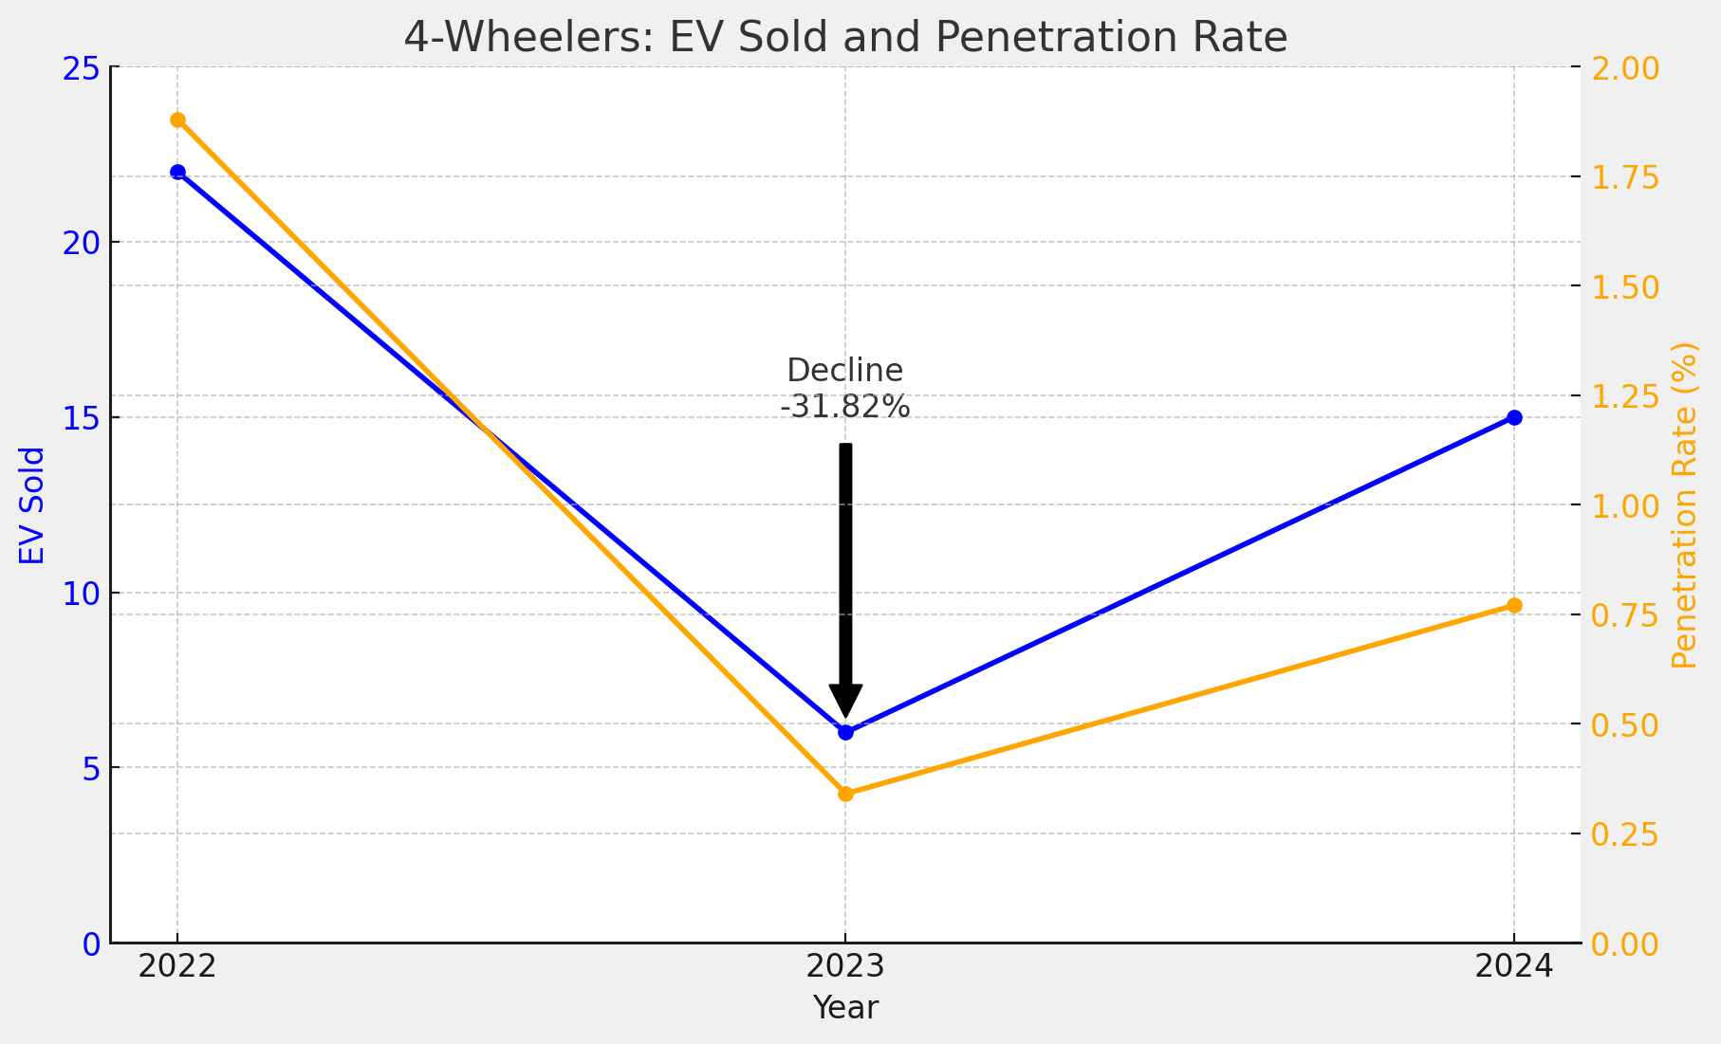


DHAVAL PATEL
Founder
@codebasics.io
HEMANAND VADIVEL
Co Founder & CEO
@codebasics.io
TEAM CODEBASICS
Notes:
Before I begin, I want to quickly thank my mentors.
Dhaval Patel Sir and hemanand Vadivel sir for their practical approaches in explaining both technical and business concepts effectively.
I also want to extend my thanks to entire codebasics team for helping me out whenever I got stuck in my career.
Without wasting much time, let’s jump into the presentation

Slide 3
AGENDA
BACKGROUND
PROBLEM STATEMENT
PROJECT OVERVIEW
PRIMARY QUESTIONS
SECONDARY QUESTIONS
RECOMMENDATION
REFERENCES
Notes:
In this presentation, I will walk you through several key components, starting with the background and problem statement to set the stage for our analysis.
Next, I’ll dive into my analysis, covering both primary and secondary insights as presented in the Codebasics Resume Project Challenge 14.
Finally, I will conclude with key recommendations and references, providing a clear roadmap for the future of the Lio-Jotstar merger.

Slide 4
BACKGROUND
OTT Market Growth & Acceleration:
The OTT streaming industry is growing rapidly, driven by internet penetration and demand for digital content.
India’s OTT market is projected to reach $12.5 billion by 2030.
Impact of COVID-19 on OTT Adoption:
COVID-19 accelerated OTT adoption; subscriptions surged by 50% as cinemas shut down.
Direct-to-digital releases became a major trend.
Why the Lio-Jotstar Merger?
LioCinema has a strong subscriber base from Lio Telecom.
Jotstar has diverse content and strong engagement.
Merging these strengths will create a powerful competitor in the OTT space.
Notes:
To set the stage, Let’s understand the background behind dominating OTT rise in Indian entertainment market.
The OTT industry has seen unprecedented growth, fueled by internet penetration and smartphone adoption.
India's OTT market is projected to hit $12.5 billion by 2030. The COVID-19 pandemic accelerated this trend, with subscriptions surging by 50% as movie threatres shut down.
This sets the perfect stage for the Lio-Jotstar merger.
LioCinema has a rapidly growing subscriber base, thanks to its telecom integration, while Jotstar is known for its extensive content library, covering both regional and international audiences.
By merging, these two platforms can dominate the Indian OTT market and expand globally.

Slide 5
PROBLEM STATEMENT
Lio, a major telecom provider in India, is merging with Jotstar, a leading streaming platform.
The goal is to leverage Lio’s subscriber base and Jotstar’s diverse content to dominate the OTT market.
Business Objective:
Analyze performance and user behavior to inform merger decisions.
Establish Lio-Jotstar as India’s leading OTT platform.
Notes:
Lio, a major telecom provider in India, is merging with Jotstar, a leading streaming platform.
The goal is to combine Lio’s strong subscriber base with Jotstar’s content-rich library to create a powerful OTT competitor.
To achieve this, we conducted an in-depth analysis of performance, user behavior, and content trends from January to November 2024.
Our findings will help Lio-Jotstar make data-driven decisions and optimize content strategy post-merger.

Slide 6
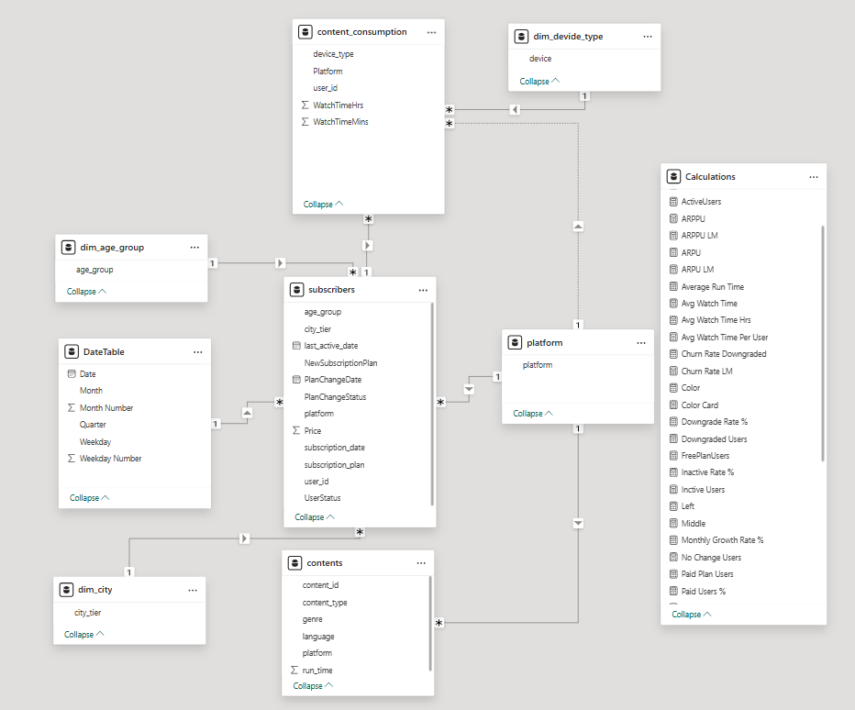
PROJECT OVERVIEW
Scope of Analysis:
Content Library & Consumption Patterns
Subscriber Growth & Demographics
Inactivity Trends & Retention
Subscription Upgrade & Downgrade Trends
Revenue & Market Insights
Data Model: Star Schema
Datasets:
Below data for both Liocinema and Jotstar
Subscribers
Content_consumption
Content
Notes:
1-- Our analysis focused on several critical areas, including:
✅ Content Library & Consumption Patterns
✅ User Growth & Demographics
✅ User Engagement & Retention Strategies ✅ Subscription Trends – Upgrades & Downgrades ✅ Revenue & Market Share Insights
2-- For this study, I used a star-schema data model and multiple datasets covering subscribers, content consumption, and revenue performance.
These insights will guide the merged entity toward sustainable growth and market leadership.

Slide 7
Key Notes:
Platform | Plan | Price (INR)
Liocinema | Basic | 69
 | Premium | 129
Jotstar | VIP | 159
 | Premium | 359
Notes:
Here are the prices of the subscription plans which serve as the foundation for our revenue analysis.

Slide 8
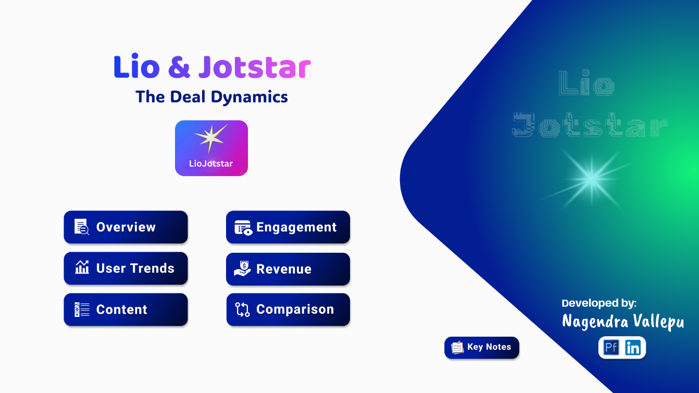
DASHBOARD
Notes:
To bring these insights to life, I developed an interactive dashboard that visualizes key performance metrics.
This dashboard provides a clear picture of monthly growth, content preferences, user engagement levels, and revenue trends.
Please explore it and share any suggestions for improvement!
Now, without wasting much time, let’s move on to our analysis and findings.

Slide 9
PRIMARY QUESTIONS
Notes:
first, let’s address the primary research questions that guided our analysis

Slide 10
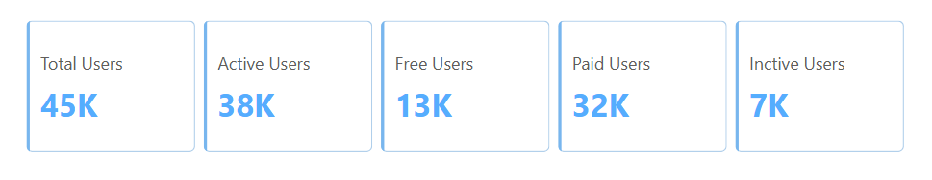
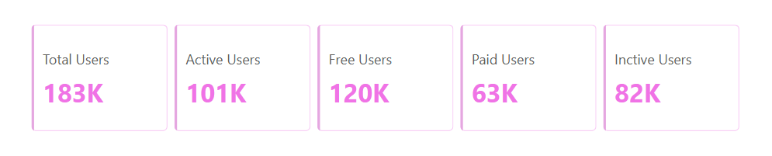
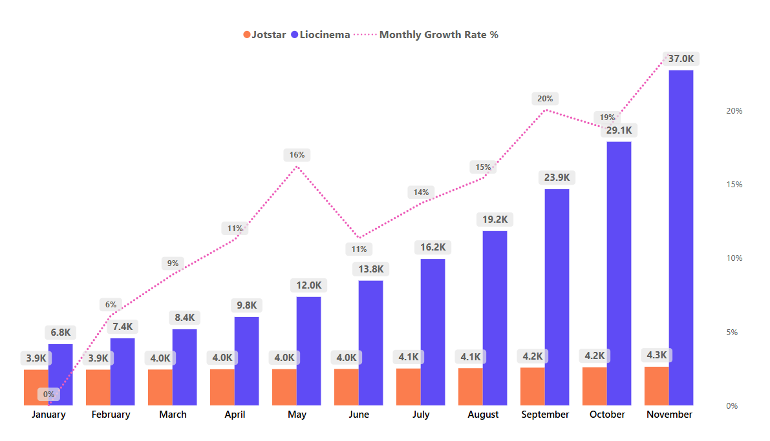
1. Total Users & Growth Trends
What is the total number of users for LioCinema and Jotstar, and how do they compare in terms of growth trends (January–November 2024)?
JotStar
Liocinema
(85%)
(29%)
(71%)
(15%)
(55%)
(65%)
(35%)
(45%)
Growth Trend :
Notes:
1-- As of November 2024, Jotstar has 45K users, while LioCinema is significantly ahead with 183K subscribers.
However, when it comes to engagement, 85% of Jotstar users are active, compared to only 55% for LioCinema—a major factor in user retention.
2-- But here’s where it gets really interesting—LioCinema’s overall growth rate is a massive 447% since January, compared to Jotstar’s 8.34% growth over the same period.
Even though Jotstar currently has higher engagement, LioCinema’s rapid momentum signals a major shift.
At this pace, LioCinema is on track to surpass Jotstar in total active users by mid-2025, making it the platform to watch!

Slide 11
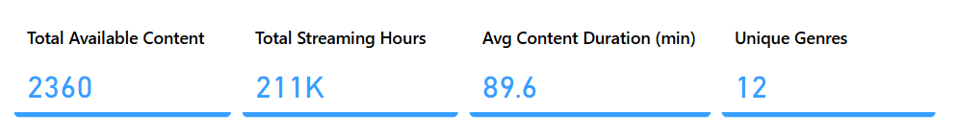
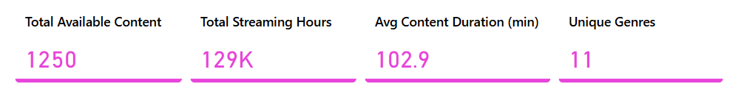
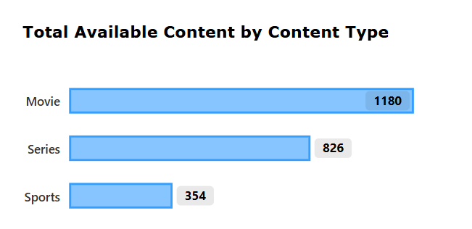
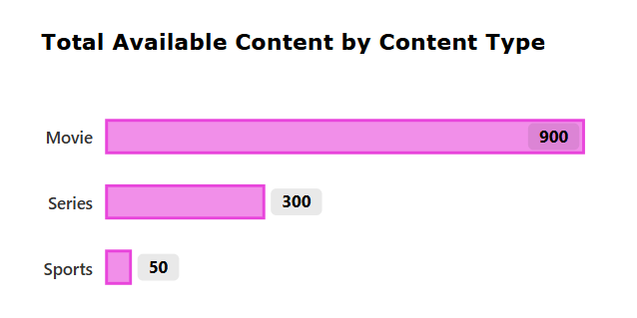
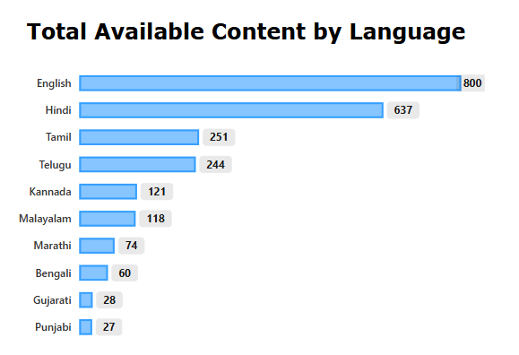
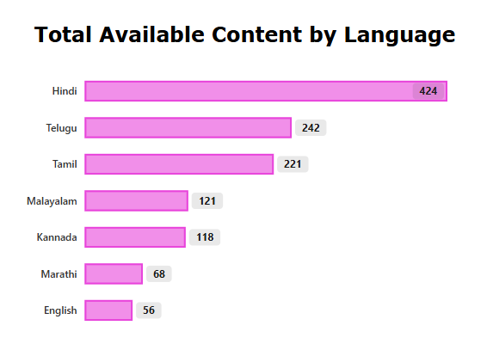
2. Content Library Comparison
What is the total number of contents available on LioCinema vs. Jotstar? How do they differ in terms of language and content type?
JotStar
Liocinema
Notes:
1-- Jotstar has a bigger library with 2,300+ titles, compared to LioCinema’s 1200.
2-- But, when it comes to regional content, LioCinema has a stronger South Indian catalog, with over 800 titles, whereas Jotstar dominates in Hindi and international content.
So, depending on the target audience, each platform has its edge.

Slide 12
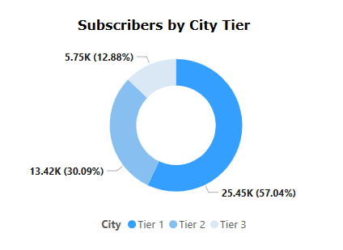
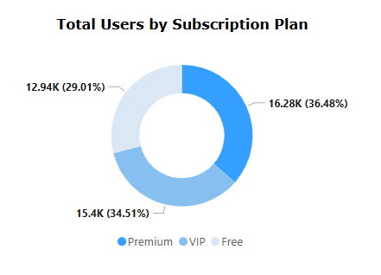
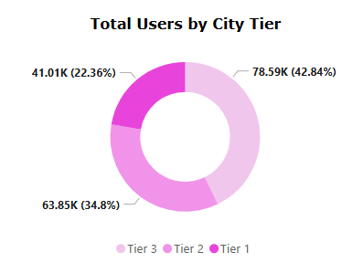
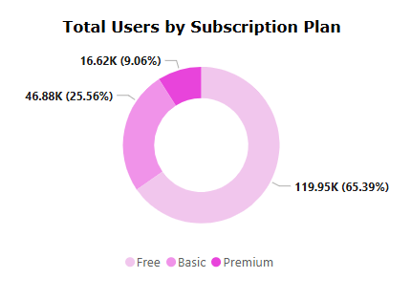
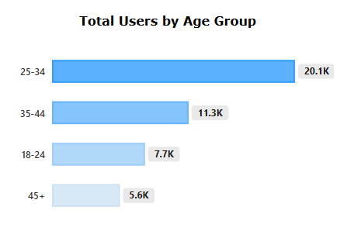
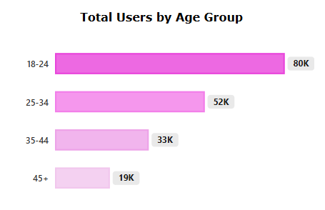
3. User Demographics
What is the distribution of users by age group, city tier, and subscription plan for each platform?
JotStar
Liocinema
Notes:
Demographics-wise, Jotstar has 60% of its users from Tier 1 cities, whereas LioCinema has a more even distribution, with 48% from Tier 1, 35% from Tier 2, and 17% from Tier 3.
This suggests that LioCinema has better penetration in smaller cities, which could be crucial for future growth.

Slide 13
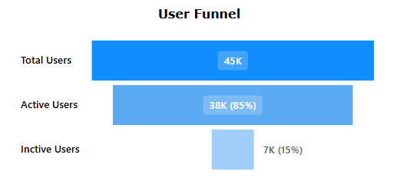
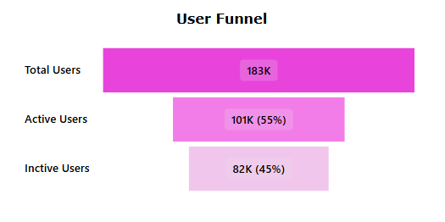
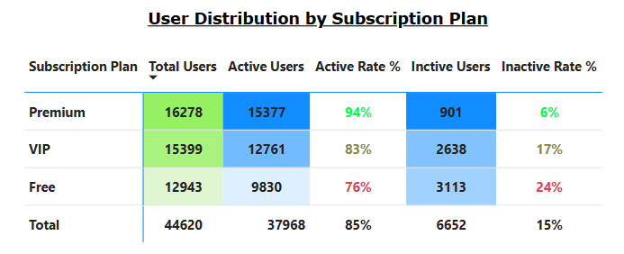
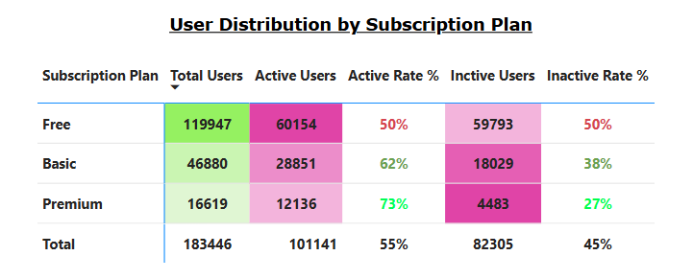
4. Active vs. Inactive Users
What percentage of LioCinema and Jotstar users are active vs. inactive? How do these rates vary by age group and subscription plan?
JotStar
Liocinema
Notes:
1-- Jotstar demonstrates a significantly higher engagement rate, with 85% of its users remaining active, compared to LioCinema's 55% active rate.
2-- Looking at the premium segment, Jotstar leads with an impressive 94% activity rate, whereas LioCinema sees only 74% of its premium users actively engaging with the platform.
This highlights a clear difference in user retention and engagement between the two platforms, providing valuable insights into potential strategies for improving activity levels on LioCinema.

Slide 14
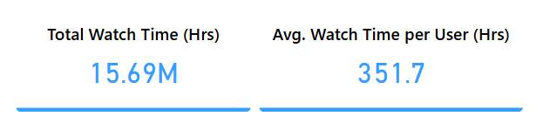
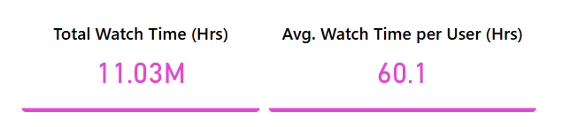
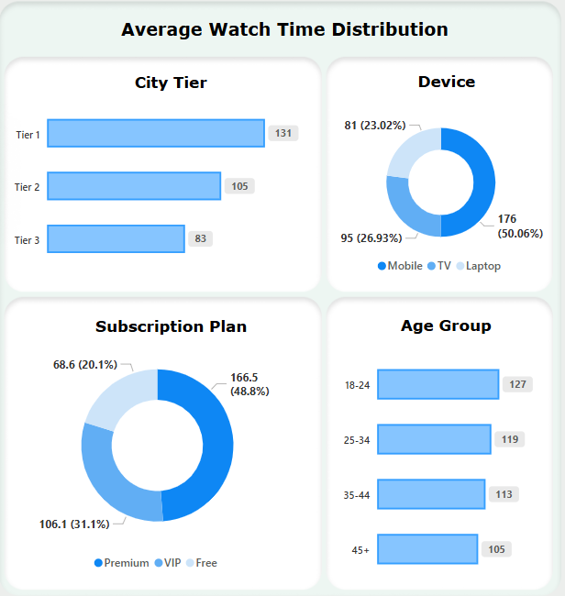
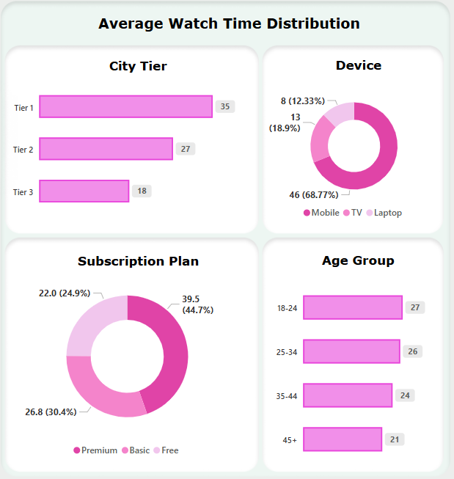
5. Watch Time Analysis
What is the average watch time for LioCinema vs. Jotstar during the analysis period? How do these compare by city tier and device type?
JotStar
Liocinema
Notes:
1-- Jotstar users average 351 Hours per user, while LioCinema users stick around for 60 hours.
That’s a whooping 290+ hours of difference per session, which adds up significantly over time.
2-- When analyzing watch time by device, LioCinema is heavily mobile-centric, with 70% of users streaming on mobile. In contrast, Jotstar maintains a more diversified distribution, with 50% on mobile, 26% on smart TVs, and 24% on laptops.
This broader reach across devices could position Jotstar for long-term growth, especially as smart TV adoption continues to rise, enhancing engagement and user retention.

Slide 15
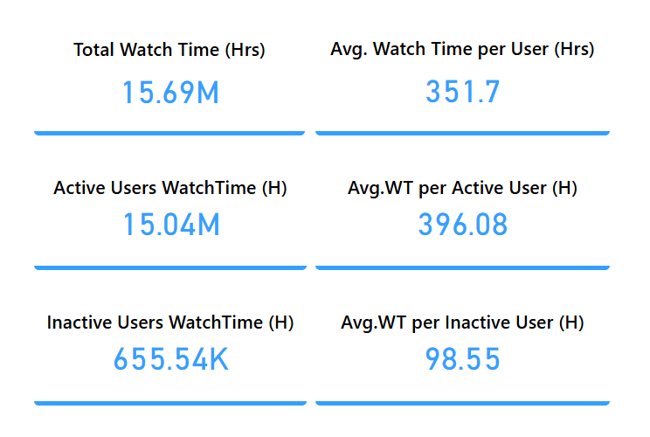
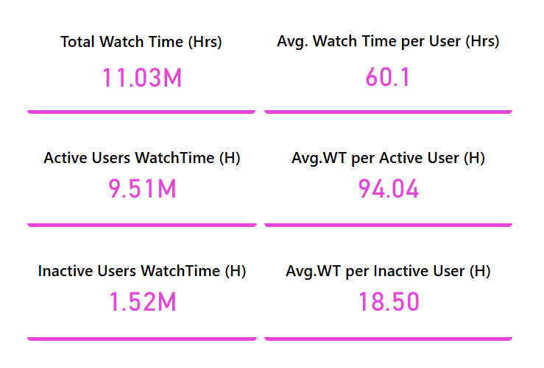
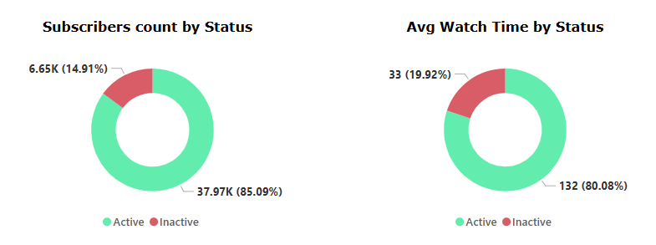
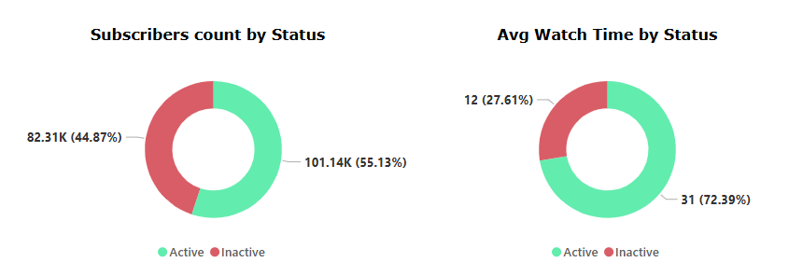
6. Inactivity Correlation
How do inactivity patterns correlate with total watch time or average watch time? Are less engaged users more likely to become inactive?
JotStar
Liocinema
Notes:
1-- JotStar has a highly engaged user base, with an average watch time of 351.7 hours per user, compared to just 60.1 hours in LioCinema.
2-- Despite LioCinema’s rapid growth, 51% of its users are inactive, while JotStar retains 85% active users.
Even inactive users in JotStar watch more (98.5 hours) than LioCinema’s active users (94 hours)—highlighting an engagement gap.\
From this numbers, we can say that the LioCinema needs to boost engagement to convert its growing user base into loyal, active viewers. 🚀

Slide 16
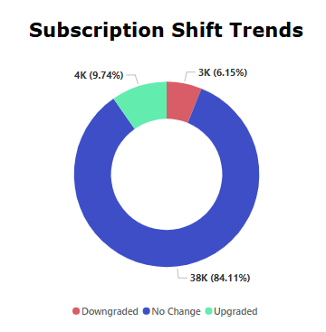
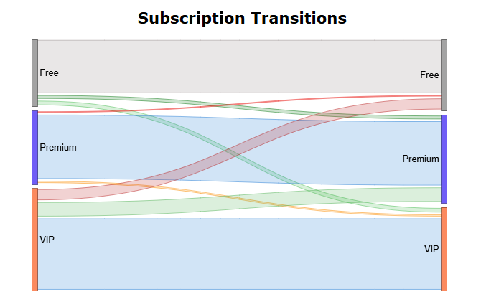
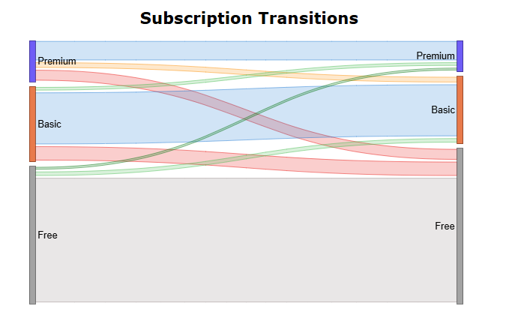
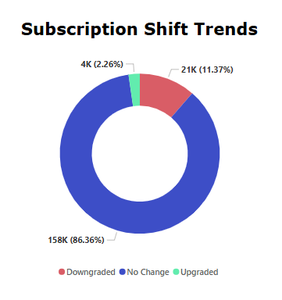
7. Downgrade Trends
How do downgrade trends differ between LioCinema and Jotstar? Are downgrades more prevalent on one platform compared to the other?
JotStar
Liocinema
Premium – Free : 225 (08%)
VIP – Free : 2149 (79%)
Premium – VIP : 368 (13%)
Premium – Free : 7439 (36%)
Basic – Free : 10309 (49%)
Premium – Basic : 3111 (15%)
Notes:
JotStar faces a VIP retention challenge, with 79% downgrading to Free—highlighting a need to enhance high-tier benefits.
LioCinema, on the other hand, struggles with overall retention, as 49% of Basic and 36% of Premium users drop to Free.
This suggests engagement challenges and a need for stronger incentives to keep users subscribed.
From this, We can say that
JotStar must enhance VIP benefits to justify the premium experience and reduce churn.
LioCinema should focus on retention strategies to improve subscriber longevity and minimize downgrades.

Slide 17
8. Upgrade Patterns
What are the most common upgrade transitions (e.g., Free to Basic, Free to VIP, Free to Premium) for LioCinema and Jotstar? How do these differ across platforms?
JotStar
Liocinema
Free – Premium : 225 (06%)
Free – VIP : 844 (22%)
VIP – Premium : 2821 (72%)
Free – Premium : 715 (17%)
Free – Basic : 2078 (50%)
Basic – Premium : 1362 (33%)
Notes:
On the flip side from downgrades, when looking at upgrades,
JotStar sees the highest upgrades from VIP to Premium (72%), indicating strong value in its top-tier plan. However, only 6% of Free users jump to Premium, showing weak direct conversions.
LioCinema has higher Free-to-Basic (50%) and Basic-to-Premium (33%) transitions, suggesting a more gradual upgrade path, but better engagement across tiers.
So, JotStar should improve entry-level conversion, while LioCinema could focus on Premium adoption strategies.

Slide 18
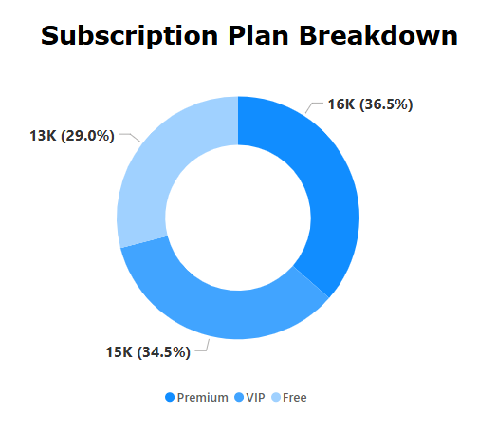
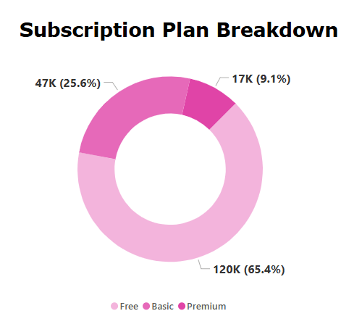
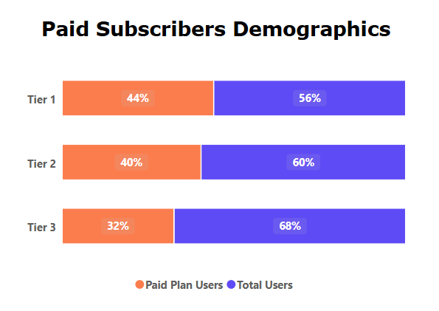
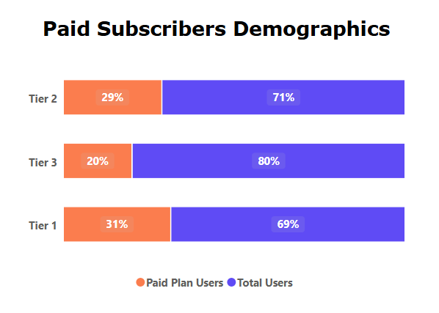
9. Paid Users Distribution
How does the paid user percentage (e.g., Basic, Premium for LioCinema; VIP, Premium for Jotstar) vary across different platforms? Analyse the proportion of premium users in Tier 1, Tier 2, and Tier 3 cities and identify any notable trends or differences.
JotStar
Liocinema
Notes:
JotStar maintains a strong paid user base, with nearly 70% on VIP or Premium plans. Paid adoption is highest in Tier 1 cities (44%) but drops to 32% in Tier 3.
LioCinema relies more on Free users (65%), with just 9% on Premium. Paid adoption is weak across all city tiers, especially in Tier 3 at only 20%.
With this we can understand that JotStar’s premium model scales well, while LioCinema needs better conversion strategies, particularly in lower-tier cities.

Slide 19
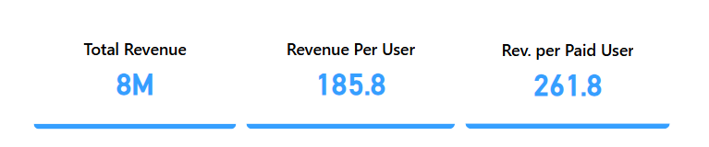
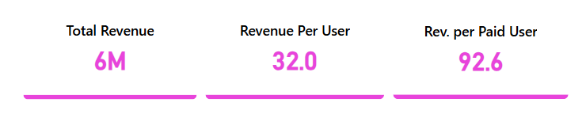
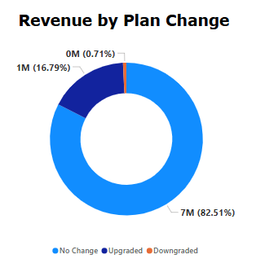
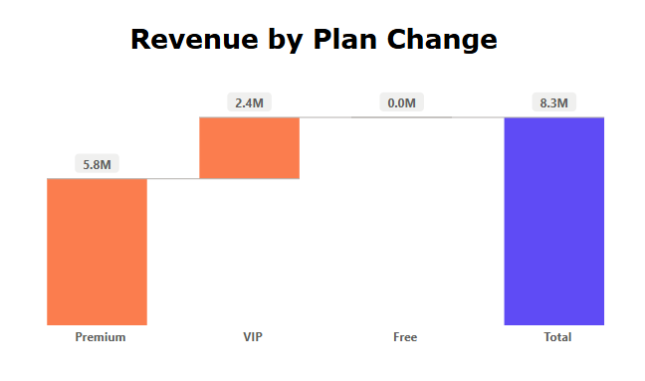
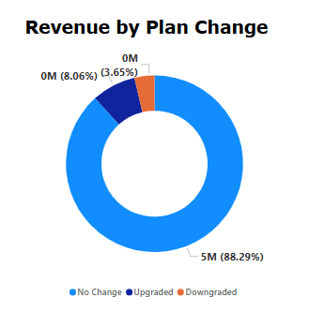
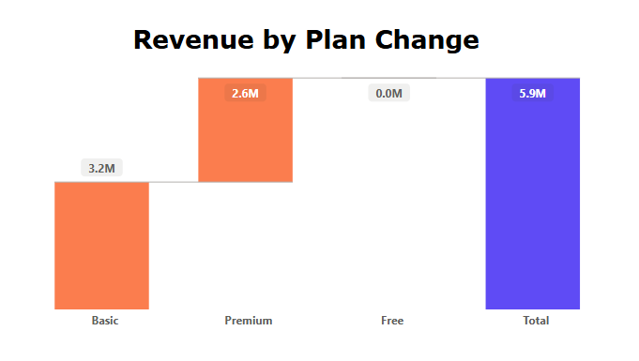
10. Revenue Analysis
Assume the given monthly subscription prices, calculate the total revenue generated by both platforms (LioCinema and Jotstar) for the analysis period (January to November 2024).
JotStar
Liocinema
Notes:
1. JotStar leads in revenue, outperforming LioCinema in total earnings and revenue per user.
Upgrades drive JotStar's growth, while LioCinema relies more on basic plans.
LioCinema should boost premium adoption with better incentives.
This indicates that while Jotstar earns more overall with it’s very less user base, LioCinema’s pricing structure might need adjustments to maximize revenue potential.

Slide 20
SECNDARY ANALASYS & RECOMMENDATIONS
Notes:
Let’s Move on to Secondary Analysis and Recommendations

Slide 21
1. What strategies can the merged platform implement to increase engagement among inactive users and convert them into active users?
To convert inactive users into active users, the platform should focus on re-engagement strategies:
Personalized Content Recommendations: Use AI-driven suggestions based on past viewing history to keep users engaged.
Exclusive Limited-Time Access: Offer short-term free access to premium content to entice inactive users.
Push Notifications & Email Campaigns: Target inactive users with customized reminders, new releases, and personalized discounts.
Gamification & Rewards: Introduce loyalty programs that offer watch streak rewards, referral bonuses, or exclusive sneak peeks.
Flexible Subscription Options: Allow users to pause instead of canceling their subscription, reducing churn.
Notes:
1. let’s focus on how to convert inactive users into active users.
39% of users are inactive, and engagement is key. To bring them back, I recommend:
2-- AI-driven content recommendations based on user preferences 3-- Exclusive free trials of premium content 4-- Push notifications and personalized email campaigns 5-- Gamification & reward systems like streak-based incentives
6-- and by providing Flexible Subscription Options
These strategies can increase reactivation rates and improve retention.

Slide 22
2. What type of brand campaigns should the merged platform launch to establish itself as the go-to OTT platform in India?
Regional & Hyperlocal Marketing:
Given the diverse language preference, launch campaigns targeting Tier 2 & Tier 3 cities with regional influencers.
Live Events & Sports Streaming:
Capitalize on live matches & sports content by partnering with sports leagues and running match-time engagement activities.
Cross-Platform Collaborations:
Partner with social media influencers, YouTube creators, and meme pages for viral marketing.
Bollywood & Pop Culture Tie-Ups:
Sponsor movie premiers, web series launches, and music video releases to attract moviegoers.
Freemium Model with Premium Teasers:
Allow first episodes of trending shows for free, pushing users to upgrade.
Notes:
To make Lio-Jotstar, an India’s go-to OTT platform, strategic brand campaigns are essential. I recomend
1-- Regional & hyperlocal marketing with influencers in Tier 2 & Tier 3 cities 2-- Live sports events & exclusive partnerships with sports leagues 3-- Cross-platform social media collaborations to reach younger audiences 4-- Bollywood and pop-culture tie-ups for mass appeal
5– and providing Freemium Model with Premium teasers
This approach ensures that Lio-Jotstar dominate both mainstream and regional markets.

Slide 23
3. How should the merged platform price its subscription plans to compete effectively while maintaining profitability?
Tiered Pricing Strategy:
Keep a low-cost ad-supported plan for budget users.
Introduce family packs for shared accounts.
Offer student discounts to attract the youth.
Dynamic Pricing Based on Engagement:
Give lower renewal rates to loyal users while maintaining higher rates for new sign-ups.
Special Festival & Seasonal Discounts:
Target users during festive seasons (Diwali, IPL, Christmas) with limited-time discounts.
Notes:
A smart pricing model will ensure maximum subscriber growth while maintaining profitability. By balancing affordability and value, Lio-Jotstar can effectively compete with global OTT players while expanding its user base.
To achieve this, I recommend:
1--- Affordable ad-supported plans for budget users Premium family & student plans to attract new audiences 2--- Dynamic pricing based on Engagement 3--- Festival & seasonal discounts – leveraging Diwali, IPL, and holiday seasons
This approach will help Lio-Jotstar compete with global OTT players while expanding its user base.

Slide 24
4. How can the platform leverage partnerships with telecom companies to expand its subscriber base?
Bundled OTT Subscriptions:
Partner with Airtel, Jio, and Vi to offer free trials bundled with data plans.
Cashback & Discounted Data Plans:
Provide discounted mobile recharges when users subscribe to LioCinema - Jotstar premium plans.
5G-Optimized Streaming Plans:
Market "5G-exclusive" ultra-HD streaming plans through telecom companies.
Notes:
Telecom partnerships play a vital role in expanding Lio-Jotstar’s reach and user base. By collaborating with major providers, the platform can unlock new growth opportunities while enhancing user engagement.
Key partnership strategies include:
1-- Bundled OTT subscriptions with Telecom providers to attract a wider audience. 2-- Cashback & discounted data plans for premium subscribers, making streaming more affordable. 3-- 5G-optimized streaming offers for ultra-HD viewing, ensuring a seamless experience for high-speed users.
These strategic collaborations will drive cost-effective growth, boost subscriber retention, and enhance the overall viewing experience.

Slide 25
5. What role can AI and machine learning play in personalizing the user experience and improving content discovery?
AI-Powered Content Discovery:
Suggest shows based on watch history, time of day, and trending preferences.
Smart Adaptive Streaming:
Use AI to optimize video quality based on internet speed, reducing buffering issues.
Churn Prediction & Prevention:
Identify users likely to unsubscribe and send them personalized offers to retain them.
Voice & Visual Search:
Implement voice and AI-driven search recommendations, making content discovery easier.
Auto-Generated Subtitles & Dubbing:
Use AI to provide instant dubbing & subtitles in multiple languages.
Notes:
AI and machine learning can revolutionize content discovery and user engagement for Lio-Jotstar by delivering a more personalized and seamless viewing experience.
Some of Key AI-driven enhancements include:
1-- AI-powered content recommendations to boost watch time by curating shows based on user preferences and trends. 2-- Smart adaptive streaming that optimizes video quality dynamically, ensuring buffer-free playback. 3-- Churn prediction models to identify at-risk users and proactively offer retention incentives. 4–- Other things such as Voice and Visual Search & Automated multilingual subtitles & dubbing to expand global reach and accessibility.
By leveraging AI, Lio-Jotstar can significantly enhance personalization, retention, and user satisfaction, staying ahead in the competitive OTT landscape.

Slide 26


6. Who should be the brand ambassador for the newly merged OTT platform (LioCinema-Jotstar) to effectively represent its identity and attract a diverse audience?
Prabhas
Virat Kohli
Pan-India Star with Regional & Global Reach
Mass & Family Appeal
Fits the OTT Action & Fantasy Genre
Cricket Icon with Unmatched Influence
Engages Tier 1 & Tier 2 Cities
Respected & Trusted
Notes:
To make Lio-Jotstar a household name, I propose:
✅ Prabhas – A pan-India star with global appeal, perfect for regional and mass engagement
✅ Virat Kohli – India’s most-followed sports personality, ideal for building brand trust
Together, they represent India’s two biggest passions: Movies & Cricket – making them the perfect faces for the brand.

Slide 27
CONCLUSION
Key Strategic Advantages of the Merger:
Advertisement Expenditure Reduced by Over 50% – Higher profitability & reinvestment opportunities.
Subscription Plan Prices Can Be Reduced – Making premium content more affordable, attracting mass users.
Massive Increase in Subscription Base – Combining LioCinema’s rapidly growing user base with Jotstar’s diverse content library.
Dominating Market Share & Eliminating Competition – The scale and reach of the merged entity will challenge top OTT players in India.
Global Expansion Through International Content – Extending services worldwide with multilingual & regional entertainment.
Why Lio-Jotstar Will Be a Strongest OTT Platform?
LioCinema = Rapidly growing user base
Jotstar = Extensive content library (Regional & International)
💥 LioJotstar= The ultimate OTT powerhouse, set to redefine digital entertainment in India & beyond
Notes:
As we wrap up our discussion, it’s clear that the merger of LioCinema and Jotstar brings transformative benefits to the OTT landscape.
1-- By significantly reducing advertisement costs and making premium content more accessible, it is creating an unparalleled entertainment experience for users.
This merger not only expands the subscription base but also positions Lio-Jotstar as a dominant force in the industry, challenging top OTT players in India and beyond.
2– Why Lio-Jotstar will be a strongest OTT Platform??
3-- With an extensive and diverse content library, a rapidly growing user base, and global expansion opportunities, Lio-Jotstar is set to redefine digital entertainment.

Slide 28

Notes:
The future of entertainment belongs to those who seamlessly blend great content with cutting-edge technology.
With the right strategy, Lio-Jotstar has the potential to reshape OTT streaming in India and beyond.
I’d love to hear your thoughts! Explore the dashboard and share your feedback—your insights can help make it even better.
Looking forward to your suggestions and collaboration. Let’s build something amazing together! 🎬✨
Thank you! 🙌

